Slide 1
Tips and tricks for tuning NNs
Apr 20
Fei & Nish

Slide 2
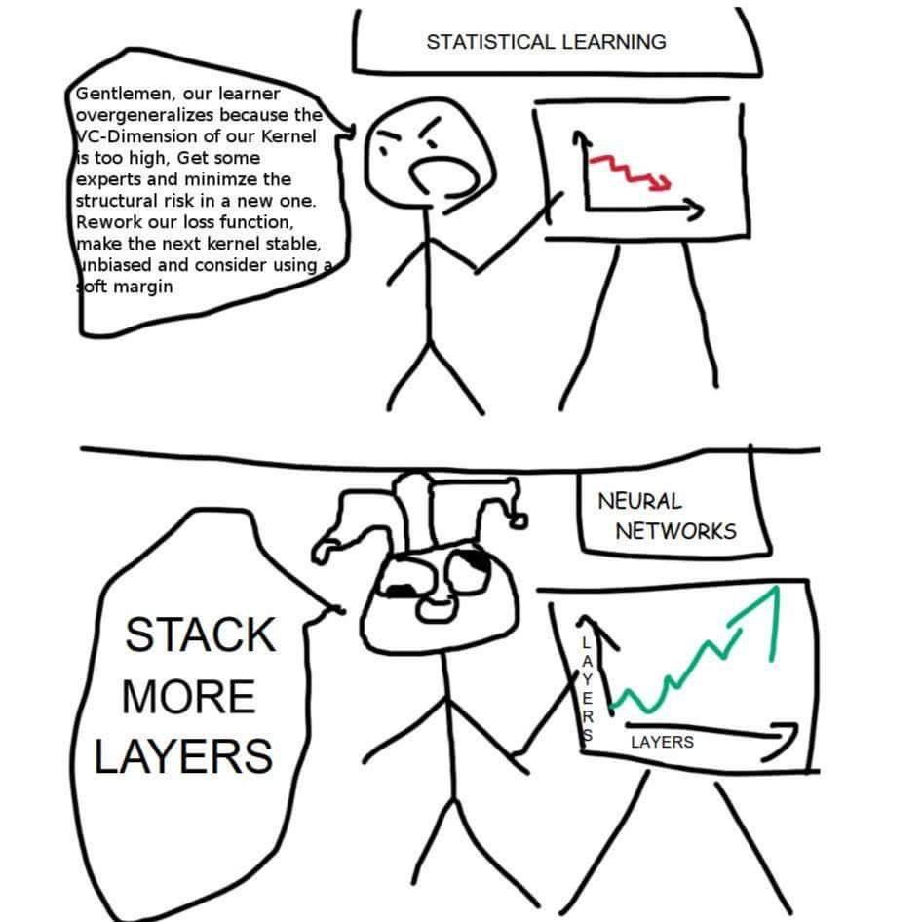

Tuning NNs can be a dark art
Notes:
Tuning NNs is hard. Part of the reason is that we don’t completely understand how exactly NNs work. For statistically learning, we have a very deep understanding of how everything operates, so in a lot of cases, we can give worst case performance guarantee or convergence guarantee. However, for deep learning, we only know a few bits here and there, so parameter tuning remains more of an art.
If you have took Andrew Ng’s 229 or 230, you probably have heard of him advocating that AI/deep learning is new electricity. But that is challenged by Ali Rahimi at NIPS’17, as he claims AI is more like new alchemy, with the emphasis on lack of theoretically understandings.
However, we do see silver lining, some of the methods greatly reduced the need for parameter tuning and stablized the training process. For example, as you will discover in HW2, batch normalization stabilized a lot of very deep NN training tasks. Another example is that WGAN stabilized GAN training process.

Slide 3
When NNs don’t work, you have many choices
Your choices: (from Andrew Ng’s talk at Bay Learn’17)
Fetch more data
Add more layers to Neural Network
Try some new approach in Neural Network
Train longer (increase the number of iterations)
Change batch size
Try Regularization
Check Bias Variance trade-off to avoid under and overfitting
Use more GPUs for faster computation
...
Notes:
In last year’s bay learn conference, Andrew gave a talk titled bolts and nuts of machine learning. He listed some go-to choices when a NN doesn’t work. In this discussion section, we will discuss how to systematically choose from those items.

Slide 4
How to systematically attempt to fix a NN?

Slide 5
Abstraction of hyperparameter tuning
Your input : Hyper parameters
Architecture (#layers, #kernels, stride, kernel size)
Learning rate, optimizer (momentum)
Regularizations (weight decay rate, dropout probability)
Batchnorm / no batchnorm
Your output: Some diagnostic statistics:
Loss curves
Gradient norms
Accuracy / Visual output (generative models)
Performance on training vs validation set
Other abnormal behaviors
Notes:
Tuning a NN can be viewed as dealing with a black box. You have a few knobs that you can tune and you observe a set of output.

Slide 6
Architecture
Using or adapt from established networks (will see more later this quarter)
Classification: AlexNet, VGG, ResNet, DenseNet, …
Segmentation: FCN, Dilated Convolution, Mask RCNN
Detection: Faster-RCNN, YOLO, SSD
Image Generation: UNet, Dilated Convolution, DCGAN, WGAN
…
How to adapt:
Change number of kernels to ideal numbers
Remove / add layers
Change the structure of last few layers for your task
Notes:
For architecture tuning, we would like to start from a network in an established work, and then do some delta modifications.

Slide 7

Architecture: adapt to different input
Need to deal with larger input, stack one more conv+pool block, or change kernel size/stride
Let’s say you saw this awesome network on some related work, but the input is not the same.

Slide 8
Architecture: for different size of dataset
Small dataset, change #channels to 0.5x for example
Let’s say you saw this awesome network on some related work, but the dataset you have is much smaller

Slide 9
Architecture: for tasks
Regression task: Change to FC + linear activation
Captioning task: change to LSTM decoder
Image generation task: change to deconvolution layers
Let’s say you saw this awesome network on some related work, but the task is not the same.

Slide 10
Fast iteration
When tuning parameters, only use a small portion of the dataset for fast iteration.
Start from a larger learning rate for fast prototyping.
Class YourAwesomeDataset(torch.data.Dataset):
def __init__(root_dir, debug=False):
...
if debug:
train_files = train_files[:len(train_files)//10]
val_files = val_files[:len(val_files)//10]
Notes:
Some tricks for fast prototyping. Give a pytorch example.

Slide 11
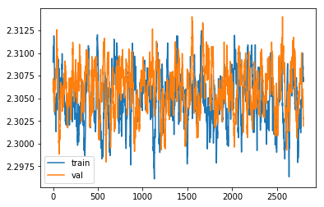
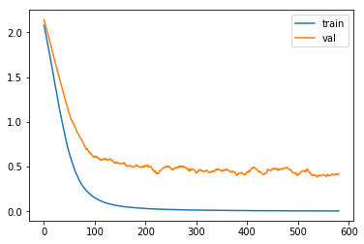
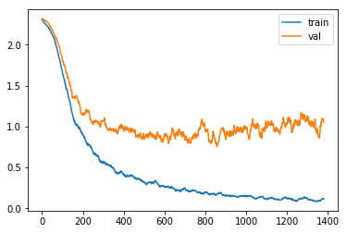
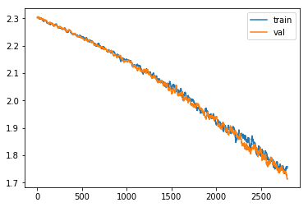
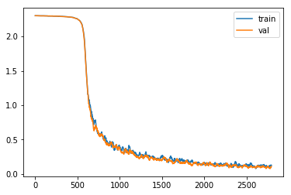
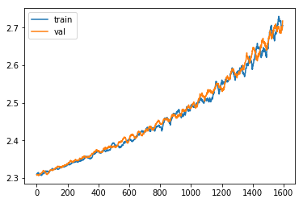
Loss curves: what are the problems?
Not learning: gradients not applied to weights
Overfit: model too large/dataset too small
More extreme case of overfitting
slow start
Not converged yet: need longer training
Slow start: initialization weights too small
Applied the negative of gradients
Notes:
Let’s see some loss curve problems and try to infer what the problem is. The importance is to go through the mental process of debugging loss curves.

Slide 12
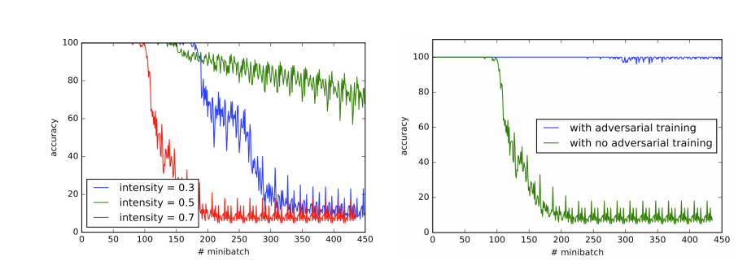
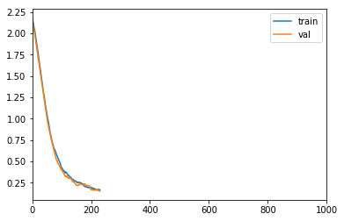
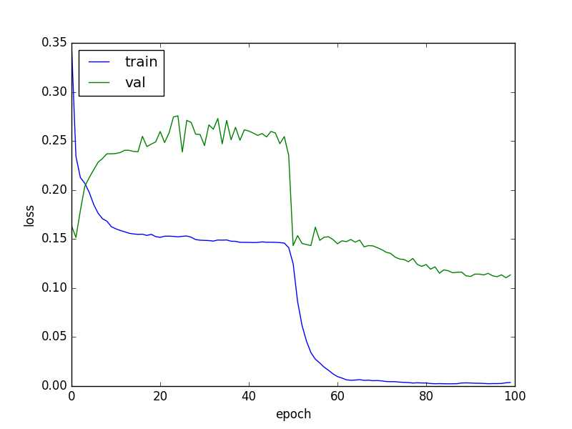
Loss curves: more examples
(or more epic fails)
Problem: Not shuffling data, periodical patterns in loss curve
Get nans in the loss after a number of iterations: caused by numerical instability in models
Problem: val set too small, statistics not meaningful
Notes:
Some harder ones.

Slide 13
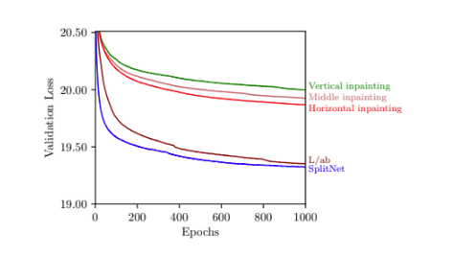
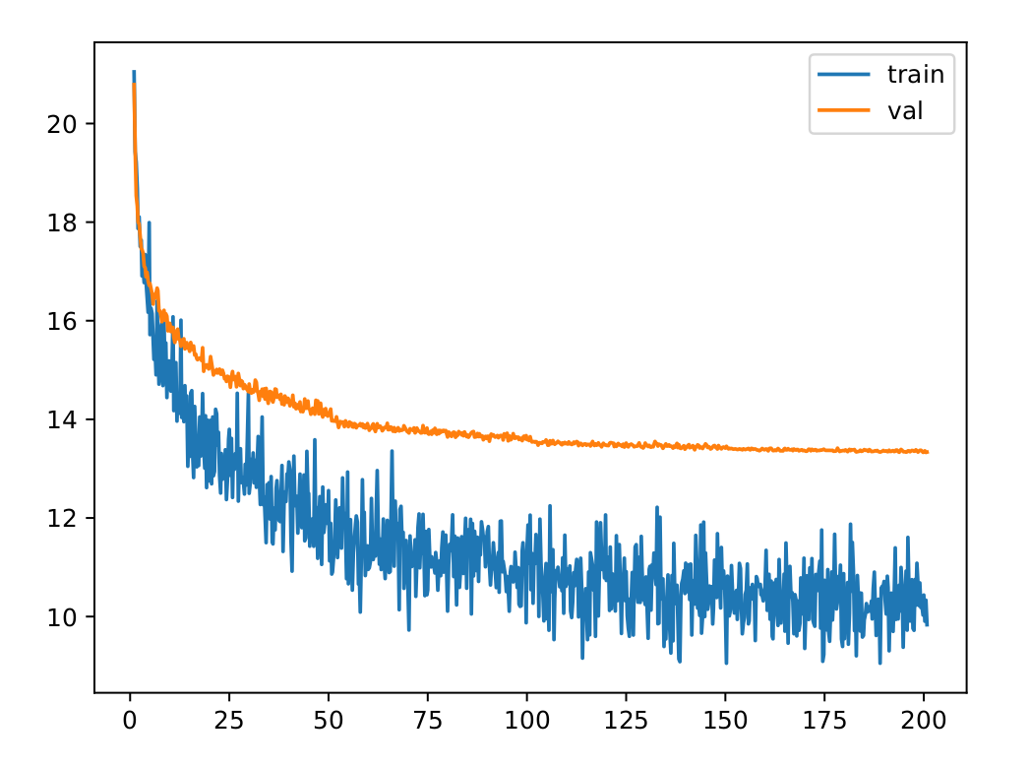
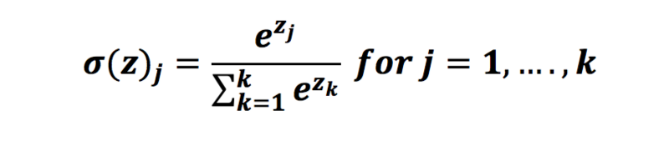
Loss curves: more examples
Problem: applied nonlinear activation before softmax
Make sure to optimize correct loss
Notes:
One example in my research.

Slide 14
Summary
Loss curve is one powerful indicator when debugging NNs
Abnormal loss curves can be caused by
Wrong implementation of data loading
Wrong implementation/choice of losses
Optimizer problems
Suboptimal hyper-parameters
Some back of the envelope calculation can help:
What do you expect the loss to start at?
What do you expect the loss to converge to?
Any ideas of how many iterations are required?

Slide 15
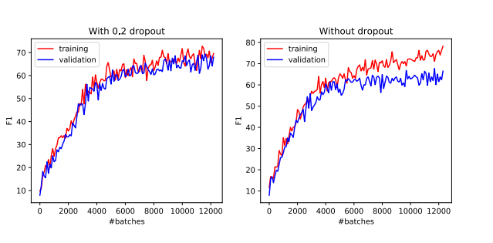
Regularization
Dropout, weight decay, use a smaller model
Tip: try overfit first, then try to close the gap between train and val.

Slide 16
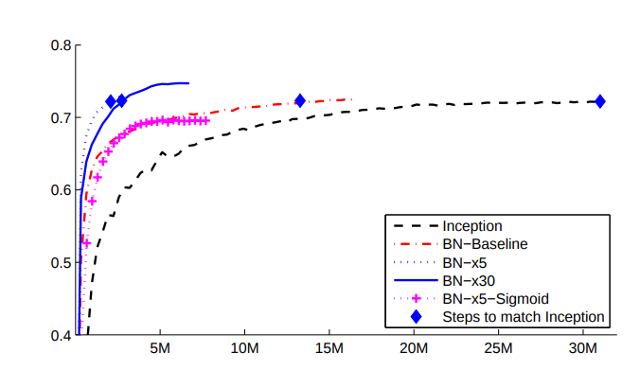
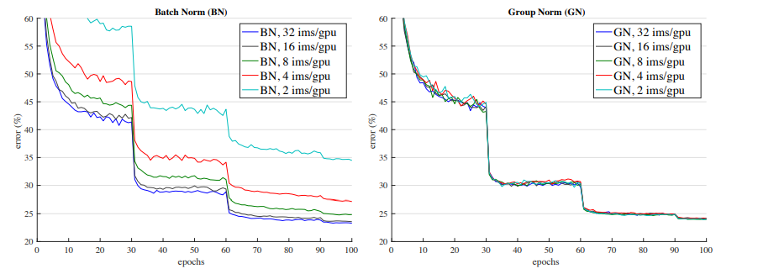
Normalization
You will explore in PS2
Trains faster
Robust to initializations
Remember to do change to evaluation mode at testing time model.eval()
Batch normalization
Group normalization

Slide 17
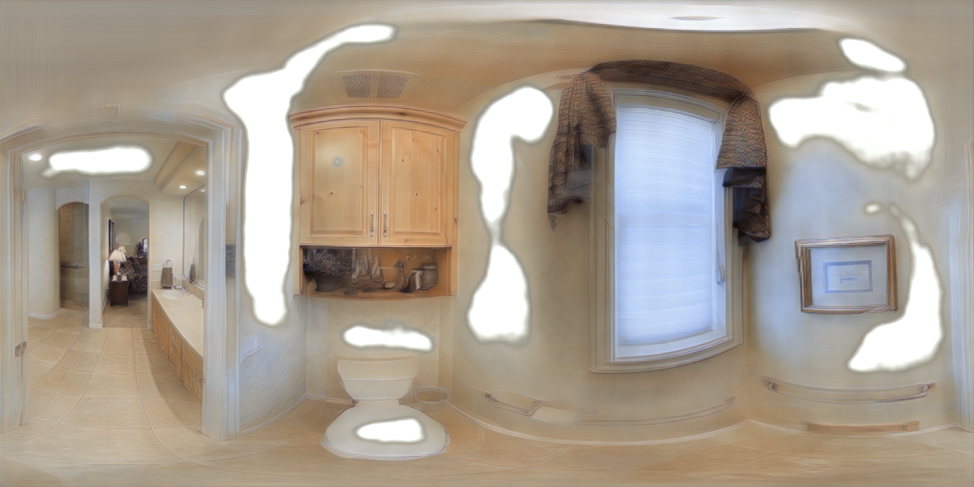
Generative models
Looking at loss curves is still insightful
Looking at visual output for pathological issues
Grid patterns
Blurry output
Inductive bias
...
Examples:

Slide 18
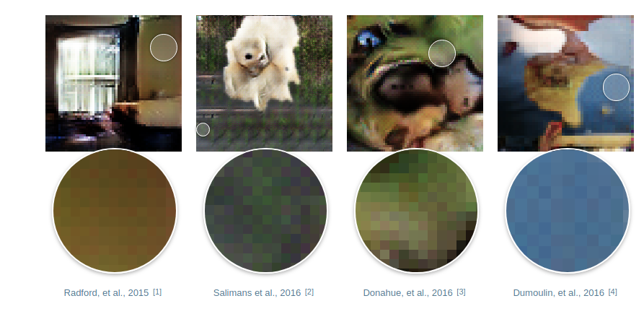
Generative models: useful references
https://github.com/soumith/ganhacks
https://distill.pub/2016/deconv-checkerboard/

Slide 19
Live code
Let’s try training a neural network on a chest xray dataset!

